Slide 1
IP SECURITY (IPsec)

Slide 2
IPsec
There are number of application-specific security mechanisms for a number of application areas:
  Electronic Mail (PGP, S/MIME)
  Client/Server Authentication (Kerberos)
  Web Access (Secure Socket Layer)
Users have security concerns that cut across protocol layers.
For example, an enterprise can run a secure, private IP network by disallowing links to untrusted sites, encrypting packets that leave the premises, and authenticating packets that enter the premises.

Slide 3
IPsec
By implementing security at the IP level, an organization can ensure secure networking not only for applications that have security mechanisms but also for the many security-ignorant applications.

Slide 4
IPsec
It is a capability that can be added to IPv4 or IPv6.
It provides:
  Authentication
    It assures that a received packet was, in fact, transmitted by the party identified as the source in the packet header.
    In addition, it assures that the packet has not been altered in transit.
  Confidentiality
    It enables communicating nodes to encrypt messages to prevent eavesdropping by third parties.
  Key Management (ISAKMP- Internet Security Association and Key Management Protocol)
    It ensures secure exchange of keys.

Slide 5
Applications of IPsec
Secure branch office connectivity over the Internet.
Secure remote access over the Internet.
Establishing extranet and intranet connectivity with partners.
Enhancing electronic commerce security.

Slide 6
IPSec
IPsec protocols operate in networking devices/gateways, such as a router or firewall.
  It typically encrypts and encompasses all traffic going into the WAN.
  It decrypts and decompresses traffic coming from the WAN.
These operations are transparent to workstations and servers on the LAN.
Secure transmission is also possible with individual users who dial into the WAN.
Such user workstations must implement the IPSec protocols to provide security.

Slide 7
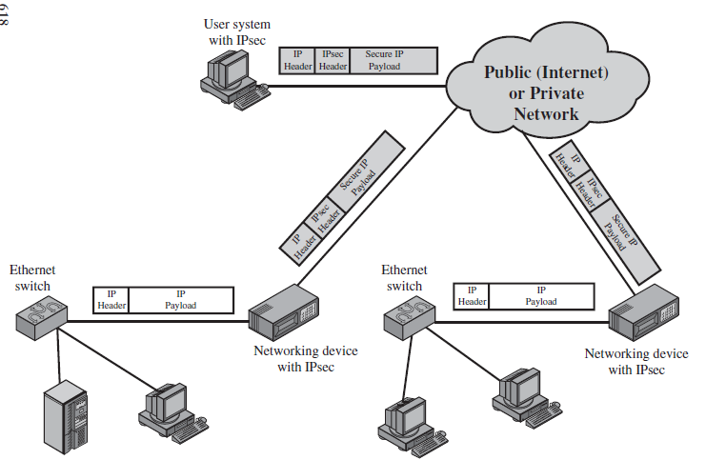
IPSec Scenario

Slide 8
Benefits of IPsec
When IPsec is implemented in a firewall or router:
  it provides strong security that can be applied to all traffic crossing the perimeter.
  Traffic within a company or workgroup does not incur the overhead of security-related processing.
IPsec in a firewall is resistant to bypass if all traffic from the outside must use IP and the firewall is the only means of entrance from the Internet into the organization.
IPsec is below the transport layer (TCP, UDP) and so is transparent to applications.
  There is no need to change software on a user or server system when IPsec is implemented in the firewall or router.
  Even if IPsec is implemented in end systems, upper-layer software, including applications, is not affected.

Slide 9
Benefits of IPsec
IPsec can be transparent to end users.
  There is no need to train users on security mechanisms, issue keying material on a per-user basis, or revoke keying material when users leave the organization.
IPsec can provide security for individual users if needed.
  This is useful for offsite workers and for setting up a secure virtual subnetwork within an organization for sensitive applications.

Slide 10
Use of IPSec
Routing Applications:
  A router advertisement (a new router advertises its presence) comes from an authorized router.
  A neighbor advertisement (a router seeks to establish or maintain a neighbor relationship with a router in another routing domain) comes from an authorized router.
  A redirect message comes from the router to which the initial IP packet was sent.
  A routing update is not forged.
Without such security measures, an opponent can disrupt communications or divert some traffic.
Routing protocols such as Open Shortest Path First (OSPF) should be run on top of security associations between routers that are defined by IPsec.

Slide 11
IP Security Architecture
Complex specification (many documents/specs)
Protocols specify:
  Architecture
  Encapsulating Security Payload (ESP)
  Authentication Header (AH)
  Encryption Algorithm
  Authentication Algorithm
  Key Management
  Domain of Interpretation

Slide 12
IPsec Services
Services at the IP Layer
  Selecting protocols, algorithms, crypto-keys
  Important security protocols: ESP and AH
ESP and AH services:
  Access control
  Connectionless integrity
  Data origin authentication
  Rejection of replayed packets
  Confidentiality (cipher text)
  Confidentiality with limited cipher text

Slide 13
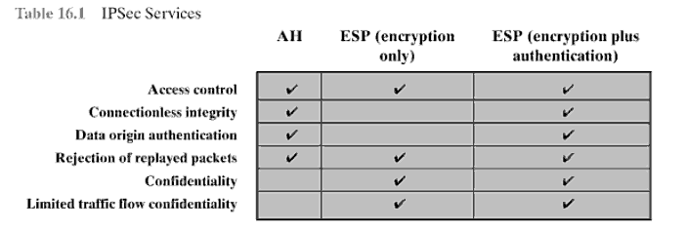
IPsec Services

Slide 14
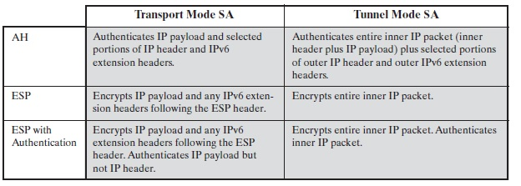
Tunnel and Transport Mode Functionality

Slide 15
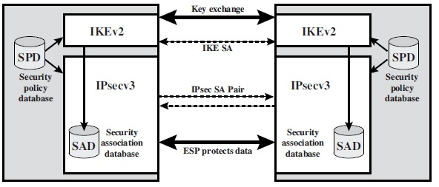
IPsec Architecture

Slide 16
Security Association (SA)
Very important concept (used throughout)
  Association: one-way relationship between sender and receiver.
  Provides security on traffic between it.
Can use two Security Associations (SA’s) for two way communication.
Services provided to AH, ESP, but not both simultaneously (but can be combined, as seen later).
SA uniquely identified by three parameters: Security Parameters Index (SPI), IP Destination Address, Security Protocol Identifier.

Slide 17
Security Association (SA)
A SA is uniquely identified by the following three parameters:
  Security Parameter Index (SPI)
    A bit string assigned to a SA and having local significance.
    It helps the receiving system to select the SA under which a received packet will be processed.
  IP Destination Address
    It is the address of the destination endpoint of SA which may be a user system or a firewall or router.
  Security Protocol Identifier
    It indicates whether the association is an AH or ESP security association.

Slide 18
Security Association Parameters in Security Association Database (SAD)
Security Parameter Index (SPI)
  A 32-bit value selected by the receiving end of an SA to uniquely identify the SA.
  In an SAD entry for an outbound SA, the SPI is used to construct the packet’s AH or ESP header. In an SAD entry for an inbound SA, the SPI is used to map traffic to the appropriate SA.
Sequence Number Counter
  A 32 bit value used to generate the sequence number field in AH or ESP.
Sequence Number Overflow
  A flag that indicate whether overflow of sequence number counter should generate an auditable event and prevent further transmission of packets on this SA.
Anti-Reply Window
  It is used to identify that inbound packet is reply or not.

Slide 19
Security Association Parameters
AH Information
  Authentication algorithm, keys, key lifetime and related parameters being used with AH.
ESP Information
  Encryption and authentication algorithm, keys, initialization values, key lifetime and related parameters being used with AH.
Life Time of SA
  A time interval or byte count after which a SA must be replaced with a new SA or terminated.
IPsec Protocol Mode:
  Tunnel, transport, or wildcard.
Path Maximum Transmission Unit (MTU):
  Any observed path maximum transmission unit (maximum size of a packet that can be transmitted without fragmentation) and aging variables (required for all implementations).

Slide 20
Security Policy Database (SPD)
IPSec: Flexibility on application of services to traffic.
How to relate IP traffic to an SA?
Security Policy Database:
  Simple idea: Table to relate subset of IP traffic to a specific SA.
  Becomes very complex (many to many relationship).
An entry is defined by a set of IP and upper-layer protocol field values, known as selectors (filter outgoing traffic to SA).
Outgoing traffic: 1) compares fields of packet against SPD, finds match. 2) Determine the SA (if exists) 3) Do IPSec (AH or ESP).

Slide 21
Selectors Determines SPD Entries
Remote IP Address:
  This may be a single IP address, an enumerated list or range of addresses, or a wildcard (mask) address.
  The latter two are required to support more than one destination system sharing the same SA (e.g., behind a firewall).
Local IP Address:
  This may be a single IP address, an enumerated list or range of addresses, or a wildcard (mask) address.
  The latter two are required to support more than one source system sharing the same SA (e.g., behind a firewall).
Next Layer Protocol:
  The IP protocol header (IPv4, IPv6, or IPv6 Extension) includes a field (Protocol for IPv4, Next Header for IPv6 or IPv6 Extension) that designates the protocol operating over IP.
  This is an individual protocol number, ANY, or for IPv6 only, OPAQUE. If AH or ESP is used, then this IP protocol header immediately precedes the AH or ESP header in the packet.

Slide 22
Selectors Determines SPD Entries
Name:
  A user identifier from the operating system.
  This is not a field in the IP or upper-layer headers but is available if IPsec is running on the same operating system as the user.
Local and Remote Ports:
  These may be individual TCP or UDP port values, an enumerated list of ports, or a wildcard port.

Slide 23
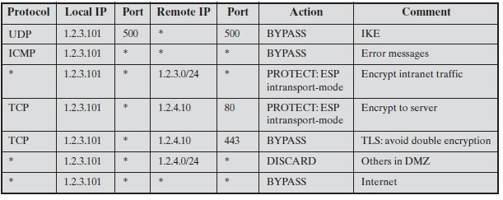
Host SPD

Slide 24
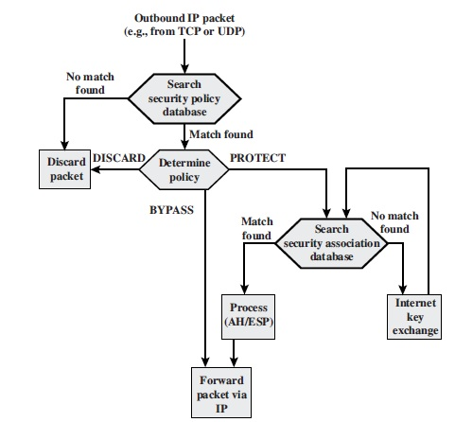
IP Traffic Processing
Outbound Packet Processing

Slide 25
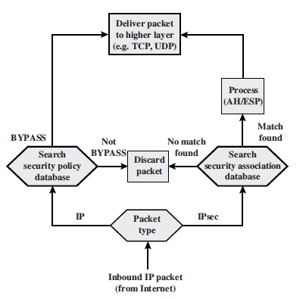
IP Traffic Processing
Inbound Packet Processing

Slide 26
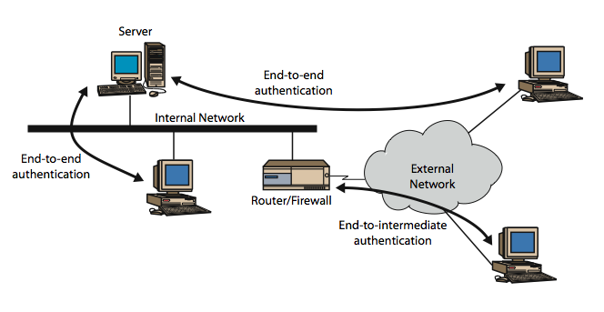
Transport and Tunnel Modes

Slide 27
Transport and Tunnel Modes
Another important concept reused:
  Transport mode: Protection of packet payload
  Tunnel mode: Protection of entire packet
Transport mode used in end to end communication between hosts.
  ESP: encrypts (+ authenticate) payload, not header
  AH: Authenticates payload, selected header bits
Tunnel mode: new routing info added
  ESP: encrypts (+ authenticate) packet(not outer header)
  AH: authenticates entire packet, selected outer bits

Slide 28
Authentication Header (AH)
Adds data integrity and authentication to IP packets
Integrity: avoid alteration of packets
Authentication: filter traffic correctly
Prevent spoof attacks and replay attacks
Uses a message authentication code (MAC)
  Required shared secret key
Uses the following fields:
  Next Header, Payload Length
  Reserved, SPI
  Sequence Number, Authentication Data

Slide 29
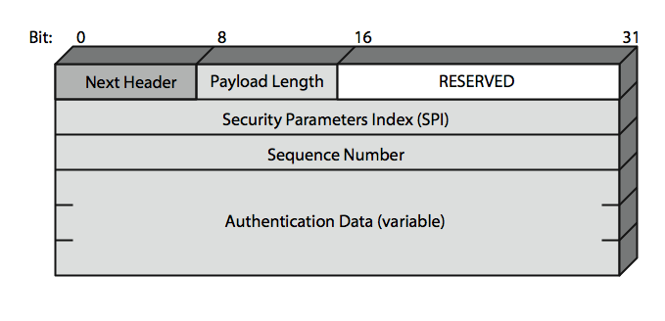
AUTHENTICATION HEADER (AH)
Packet Format(32 bits)

Slide 30
AH
Next Header (8 bits)
  Identifies the type of header immediately following this header.
Payload Length (8 bits)
Reserved (16 bits)
  For future use.
Security Parameters Index (32 bits)
  Identifies a security association
Sequence Number (32 bits)
  A monotonically increasing counter value

Slide 31
AH
Authentication Data (variable)
  A variable-length field (must be an integral number).
  The Authentication Header provides support for data integrity and authentication of IP packets.
  The data integrity feature ensures that undetected modification to a packet's content in transit is not possible.
  The authentication feature enables an end system or network device to authenticate the user or application and filter traffic accordingly; it also prevents the address spoofing attacks observed in today's Internet.
  The AH also guards against the replay attack. Authentication is based on the use of a message authentication code (MAC), hence the two parties must share a secret key. of 32-bit words) that contains the Integrity Check Value (ICV), or MAC, for this packet

Slide 32
Preventing Replay Attack
Attacker grabs authentic packet, transmits later.
Sequence Number tries to prevent this.
Sequence Number is generated by sender for a new SA
  Starts 0 and increments to 2³² – 1.
  Incremented for each new packet, thus first value, 1.
  Cannot be allowed to cycle. Passing limit must negotiate NEW SA with a NEW secret key.
  Since IP does not guarantee packet delivery order (or at all for that matter), the receiver uses the familiar sliding window concept for data transmission.

Slide 33
Sliding Window
If the received packet falls within the window and is new, the MAC is checked. If the packet is authenticated, the corresponding slot in the window is marked.
If the received packet is to the right of the window and is new, the MAC is checked. If the packet is authenticated, the window is advanced so that this sequence number is the right edge of the window, and the corresponding slot in the window is marked.
If the received packet is to the left of the window, or if authentication fails, the packet is discarded; this is an auditable event.

Slide 34
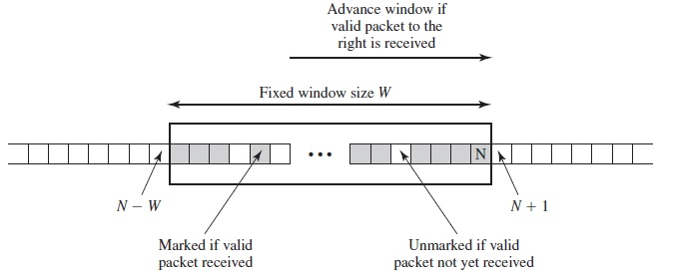
Anti-reply Mechanism

Slide 35
Encapsulating Security Payload (ESP)
Encapsulating Security Payload (ESP)
  ESP with optional Authentication
  ESP with Authentication

Slide 36
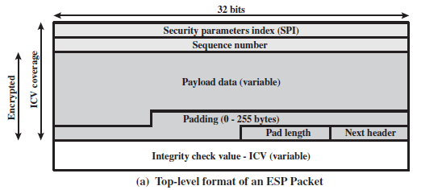
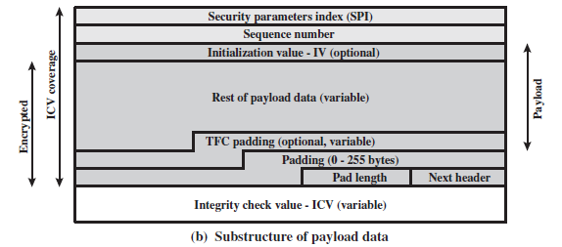
ESP Packet Format

Slide 37
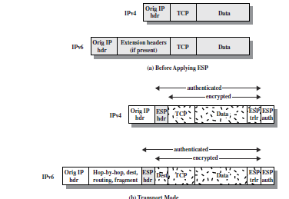
Scope of ESP encryption and authentication

Slide 38
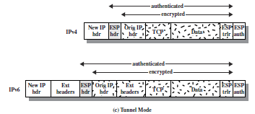
Scope of ESP encryption and authentication

Slide 39
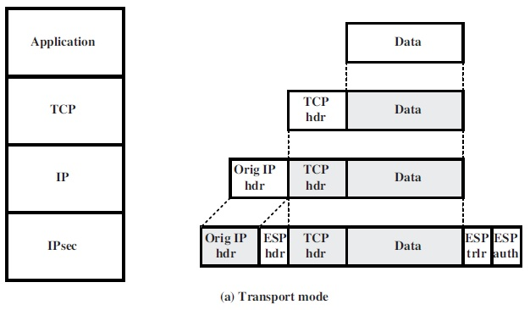
Protocol operation for ESP

Slide 40
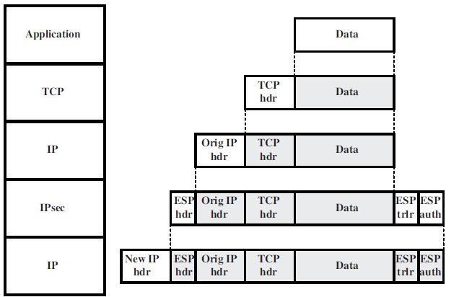
Protocol operation for ESP

Slide 41
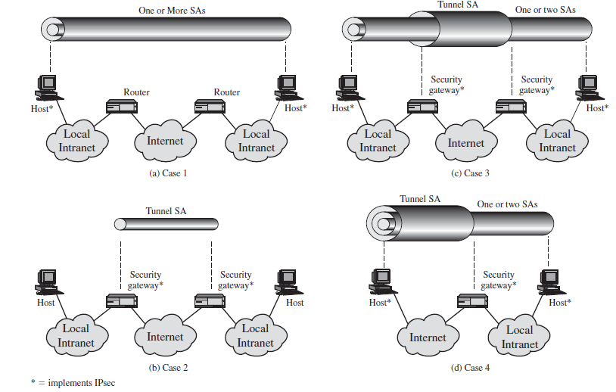
Basic Combinations of Security Associations

